Slide 1
List comprehensions
Notes:
Are your classroom colors different than what you see in this template? That’s OK! Click on Design -> Variants (the down arrow) -> Pick the color scheme that works for you!
Feel free to change any “You will…” and “I will…” statements to ensure they align with your classroom procedures and rules!

Slide 2
What is it?!
What is a lambda function | Benefits:
List comprehensions provide us with a simple way to create a list based on some iterable. Elements from the iterable can be conditionally included in the new list and transformed as needed. | Represent for and if loops with a simpler and more appealing syntax. List comprehensions are relatively faster than for loops.

Slide 3
Syntax The basic structure of a list comprehension is as follows:

Slide 4
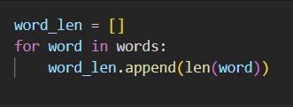

For Loop Vs. List Comprehension We want to create a list that contains of the length of each word in the words list. Let’s perform the task using both a for loop and list comprehension.

Slide 5



Simple List Comprehensions

Slide 6
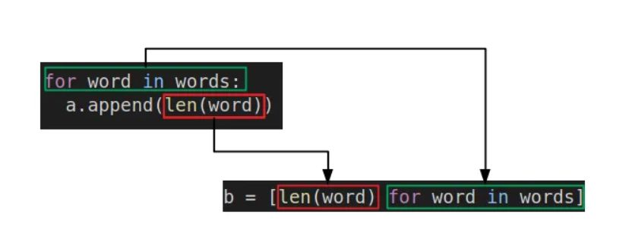


For Loop Vs. List Comprehension

Slide 7


List Comprehension With Conditional Statement

Slide 8
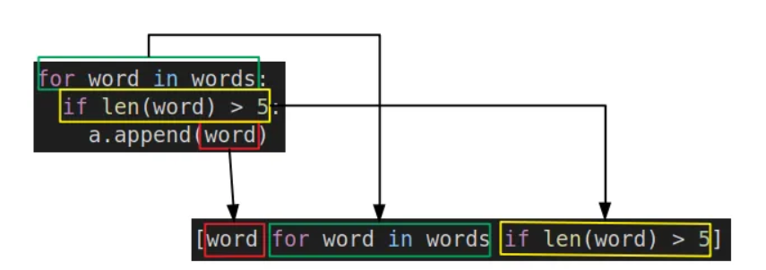
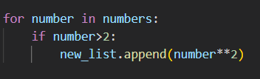

For Loop Vs. List Comprehension

Slide 9



List Comprehension With Conditional Statements

Slide 10


List Comprehension With If-Else Clause

Slide 11
Pros and Cons
Pros | Cons

